Slide 1

UniVote
Team
UniVote
Thank You
Scaling
facts
follow
planning
Impact
Prospect
market plan
A DECENTRALIZED BLOCKCHAIN PLATFORM
facts

Slide 2
The voting sector has suffered immensely due to the following problems.
These include:
Budget approved for voting was about 189billion naira in 2019.
Only about 28 million voters out of 82 million voters voted in the last Nigerian elections according to INEC
About 2 million votes out of the 28 million votes were rendered invalid due to human error
High rate of violent activities were recorded in states like Bauchi, Lagos and Kano which resulted in death of citizens
Team
Univote
UniVote
Thank You
follow
market plan
services
Planning
Facts
follow
Scaling
Impact
Team
Prospect
planning
market plan

Slide 3



UNIVOTE
DECENTRALIZED
SECURED
TRANSPARENT
1
2
3
Team
follow
UniVote
Thank You
Team
Distributed
Security is Key
Transparency
services
Planning
teams
Scaling
intro
follow
Prospect
planning
market plan
It Is Not Deployed Or Stored On A Centralized Server
It Makes Use Of The BlockChain Technology To Ensure Safety
All Data And Transactions Are Opened And Visible To The Public

Slide 4

Team
servics
UniVote
Thank You
Team
intro
follow
Prospect
Planning
follow
services
market plan
Market Plan
2019
2020
FUTURE
Planning Stage
Development Stage
??
The Theoretical Aspect Of Univote Was Coined And Processed
Here UniVote Was Built and Deployed On The BlockChain

Slide 5


Market Plan
Phase One(2020-2022)
Phase Two(2023 – 2027)
Create Awareness About Decentralized Voting Through Partnership with BlockChain Promotion Platforms
Expand Beyond The Educational Sector
Partnership With The Electoral Body To Organize Elections in Senates, Local Governments , etc.
Team
prospect
Market plan
Impact
history
follow
Team
Scaling
50 Active Universities in Nigeria. 20 Private, 30 Federal.
timeline
Thank You
intro
follow
Expand To Other African Countries Which Include Rwanda, South Africa and Kenya
Do An IPO In The Year 2027

Slide 6
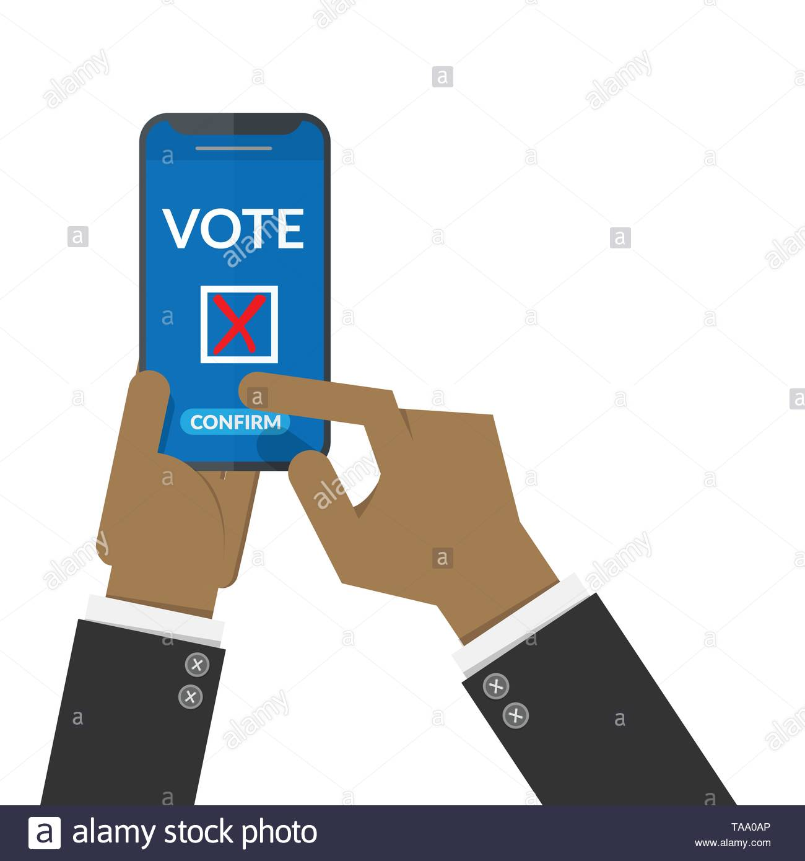
IMPACT
PILOT PROGRAM
With Your Funding and NITDA Support, UniVote will conduct the forth coming SUG elections in UniJos.
This Will Gain Global Attention As The First Decentralized Election From Companies in Europe and the U.S
Market Plan
Team
prospect
history
Scaling
Market plan
follow
impact
intro
Thank You

Slide 7


Scaling Up
For The Year 2020, Usage On UniVote Will Be Free
Release of UniVote 2.0 by Q1 2021:
Free for Universities With Less Than 1000 Voter
+
50 Naira per Student Yearly For Universities With More Than 1000 but less than 10000 students.
150 Naira per Student Yearly For Universities With More Than 10000 Students
This will save 2150 Naira per voter based on the last election
Team
prospect
history
follow
scaling
timeline
Thank You
intro

Slide 8
Prospects
BlockChain Is Set To Boost Global Trade by $1 Trillion According To The World Economic Forum
Nigeria is The Biggest Market In Africa For BlockChain Adoption
Nigeria Alone process over 4 million dollars in BlockChain related technologies on a weekly basis
BlockChain Technology Is The Second Most In-Demand Technology According To LinkedIn
Researches are Ongoing For BlockChain Elections In Turkey
Germany, Estonia, France And Other World Powers.
Team
history
Team
prospects
follow
scaling
timeline
Thank You
intro

Slide 9



Team
Thank You
follow
history
services
teams
timeline
intro
Uunivote@gmail.com
UniVote Technologies
@UniVote5

Slide 10




01
02
03
Team
follow
history
Thank You
timeline
about
teams
GOODNESS EZEOKAFOR
EMMANUEL NDUKA
STEPHEN SUNDAY
CEO, UNIVOTE
CO-FOUNDER, UNIVOTE
CTO, UNIVOTE
Business Manager, BlockChain Consultant, Entrepreneur
BlockChain Developer, programmer, Entrepreneur
BlockChain Developer, Developer, Entrepreneur

Slide 11
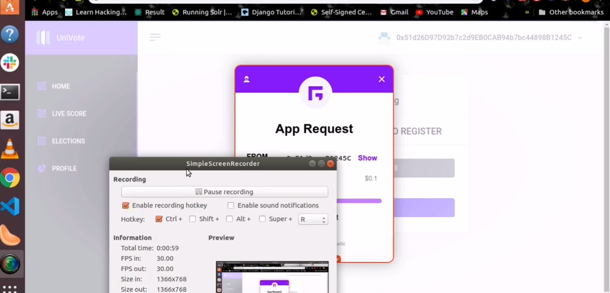

Slide 12
THANK YOU
-TEAM UNIVOTE
Univote.herokuapp.com

